Slide 1
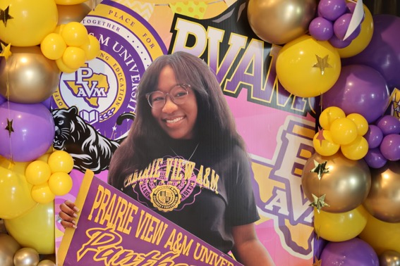
Lauryn's
HBCU Celebration
Add your featured photo here
Prairie View A&M University
Photo Station Memories
June 20, 2026
PVAMU • Class of 2030

Slide 2
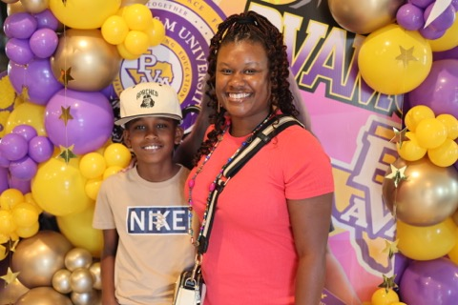
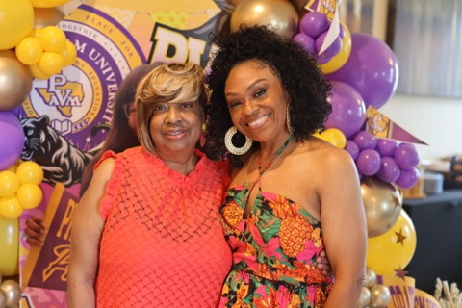
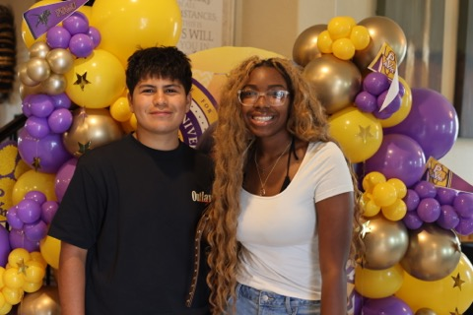
1/10
The celebration begins! ✨
Family and joy all around
Striking a pose for the grad!

Slide 3
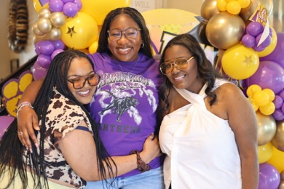
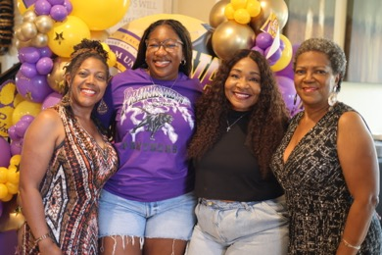
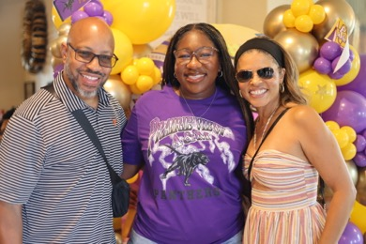
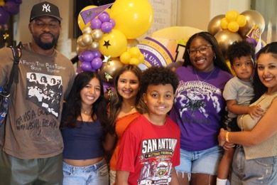
2/10
So much love in this photo
The beautiful Lauryn 🎓
Guests arriving in style
Golden smiles for a golden night

Slide 4
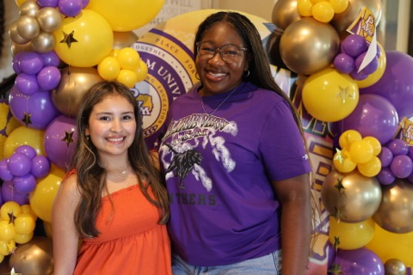
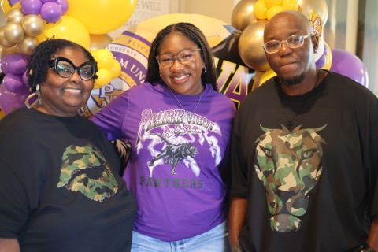
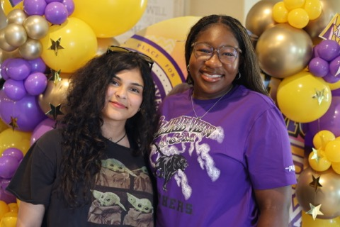
3/10
Pride, love, and celebration
Making memories that last forever
It's a PVAMU party! 🟣💛

Slide 5
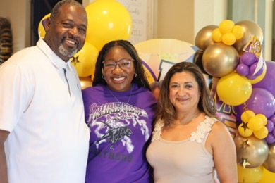
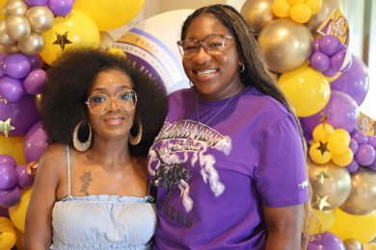
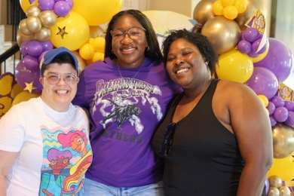
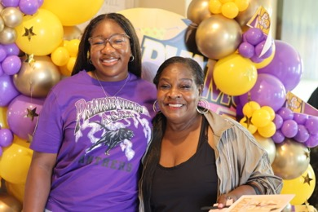
4/10
Together we celebrate you
Nothing but good vibes tonight
Capturing the magic of the night
Lauryn shining bright as always

Slide 6
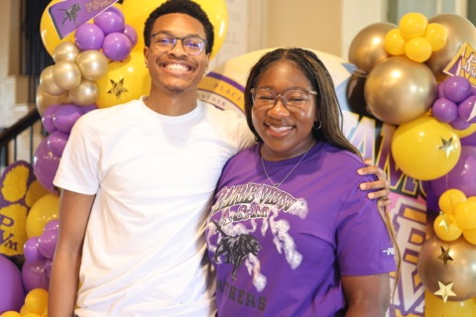
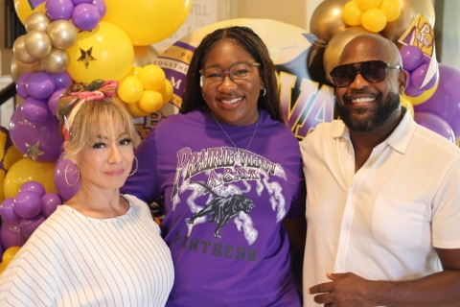
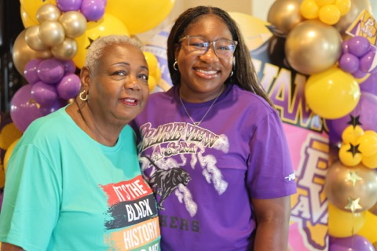
5/10
Surrounded by people who love you
The photo station comes alive!
Every shot a keepsake

Slide 7
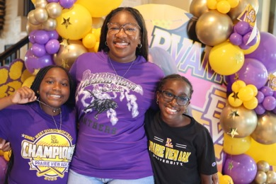
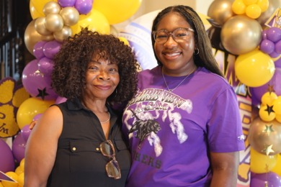
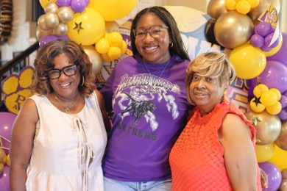
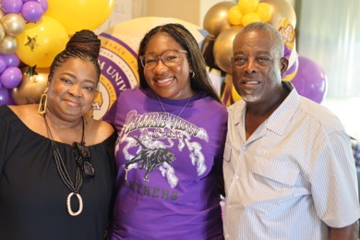
6/10
PVAMU Panthers represent!
Can't stop smiling tonight
The night belongs to Lauryn
Squad goals 💜

Slide 8
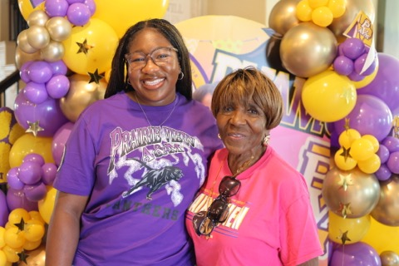
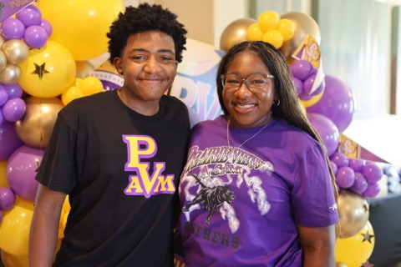
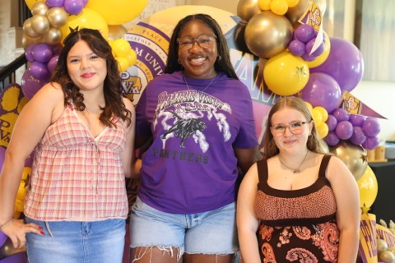
7/10
Pure happiness in every frame
Another beautiful memory made
Cheers to the graduate!

Slide 9
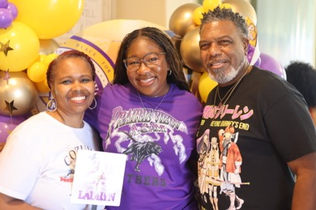
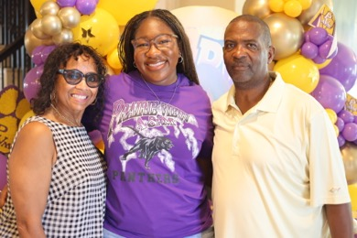
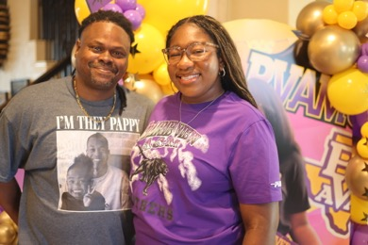
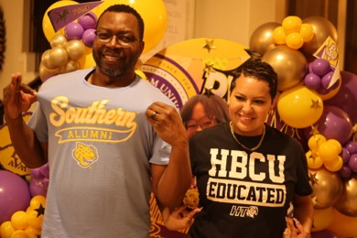
8/10
Late night but still glowing ✨
Keeping the party going
The best night of the year
Thank you for celebrating with us

Slide 10
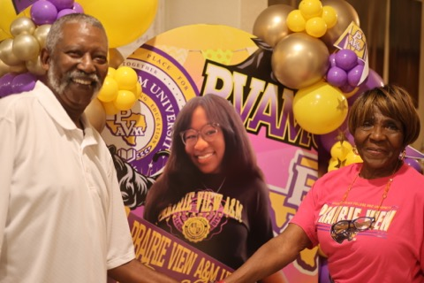
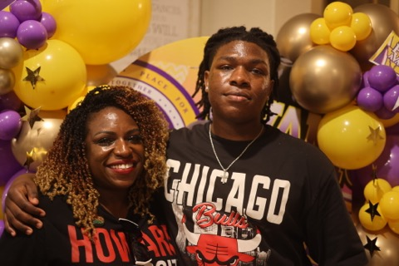
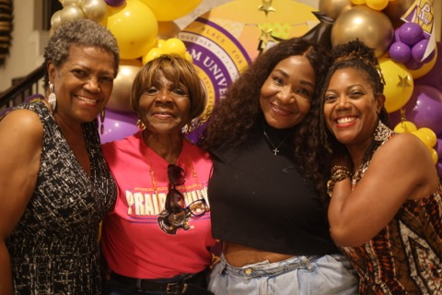
9/10
A night to remember forever
Last shots before midnight 🌙
Still going strong!

Slide 11
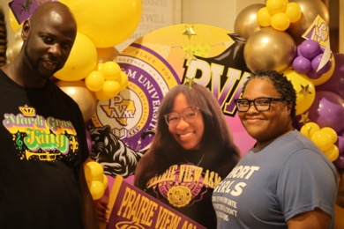
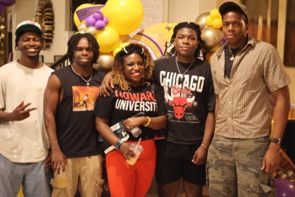
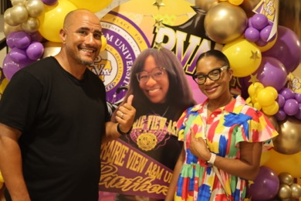
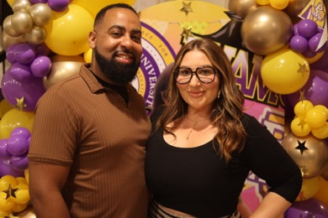
10/10
Forever grateful for this night
The PVAMU spirit lives on
Until we meet again 💛
Love you, Lauryn! 🎓🟣💛

Slide 12
Congratulations, Lauryn!
Prairie View A&M University
Thank you to everyone who celebrated with us tonight.
PVAMU • Class of 2030 • June 20, 2026

